Slide 1
Data Generation in Source Systems
Pravin Y Pawar
Adapted from
Fundamentals of Data Engineering
By Joe Reis and Matt Housley

Slide 2
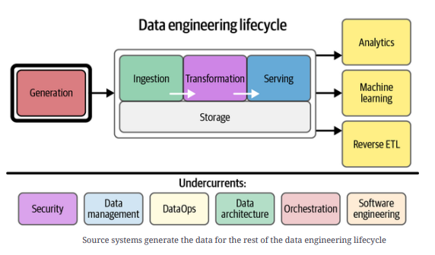
Sources of Data: How Is Data Created?
Essential to understand how data is created, as
Data is an unorganized, context-less collection of facts and
figures
Can be created in many ways, both analog and digital
Analog data
creation occurs in the real world, such as vocal speech, sign
language, writing on paper, or playing an instrument
often transient
Digital data
either created by converting analog data to digital form or is
the native product of a digital system
A mobile texting app that converts analog speech into digital
text
A credit card transaction on an ecommerce platform

Slide 3
Source Systems
Relational databases
Most common application backends - developed at IBM in the 1970s and popularized by Oracle in the 1980s
growth of the internet saw the rise of the LAMP stack (Linux, Apache web server, MySQL, PHP) and an explosion of vendor and open
source RDBMS options
Data is stored in a table of relations (rows), and each relation contains multiple fields (columns)
Each relation in the table has the same schema
Rows are typically stored as a contiguous sequence of bytes on disk
Tables are typically indexed by a primary key, a unique field for each row in the table
The indexing strategy for the primary key is closely connected with the layout of the table on disk
Tables can also have various foreign keys —fields with values connected with the values of primary keys in other tables,
facilitating joins, and allowing for complex schemas that spread data across multiple tables
Normalization is a strategy for ensuring that data in records is not duplicated in multiple places
avoiding the need to update states in multiple locations at once and preventing inconsistencies
RDBMS systems are typically ACID compliant
Relational database systems ideal for storing rapidly changing application states
Combining a normalized schema, ACID compliance, and support for high transaction rates
Challenge is to determine how to capture state information over time

Slide 4
Source Systems(2)
Non-relational databases: NoSQL
NoSQL, not only SQL, refers to a whole class of databases that abandon the relational paradigm
widely adopted to describe a universe of “new school” databases, alternatives to relational databases
dropping relational constraints can improve performance, scalability, and schema flexibility
abandon various RDBMS characteristics, such as strong consistency, joins, or a fixed schema
Numerous flavors of NoSQL database designed for almost any imaginable use case
key-value
document
wide-column
graph
search
time series
all wildly popular and enjoy widespread adoption
Should understand
these types of databases
including usage considerations
the structure of the data they store
and how to leverage each in the data engineering lifecycle

Slide 5
Source Systems(3)
Key-Value stores
A non-relational database that retrieves records using a key that uniquely identifies each record
similar to hash map or dictionary data structures presented in many programming languages but potentially more scalable
encompass several NoSQL database types —document stores and wide column databases
Different types of key-value databases offer a variety of performance characteristics to serve various application needs
In-memory key-value databases are popular for caching session data for web and mobile applications, where ultra-
fast lookup and high concurrency are required
Storage in these systems is typically temporary - if the database shuts down, the data disappears
Such caches can reduce pressure on the main application database and serve speedy responses
Key-value stores can also serve applications requiring high-durability persistence
An ecommerce application may need to save and update massive amounts of event state changes for a user and their orders
A user logs into the ecommerce application, clicks around various screens, adds items to a shopping cart, and then checks out
Each event must be durably stored for retrieval
Key-value stores often persist data to disk and across multiple nodes to support such use cases

Slide 6
Source Systems(4)
Document stores
A specialized key-value store
A document is a nested object - each document as a JSON object - are stored in collections and retrieved by key
A collection is roughly equivalent to a table in a relational database
Does not support joins - data cannot be easily normalized, i.e., split across multiple tables
Ideally, all related data can be stored in the same document.
In many cases, the same data must be stored in multiple documents spread across numerous collections
Generally embrace all the flexibility of JSON and don’t enforce schema or types - blessing and a curse
allows the schema to be highly flexible and expressive - can also evolve as an application grows
become absolute nightmares to manage and query - data may become inconsistent and bloated over time
Support the creation of indexes and lookup tables to allow retrieval of documents by specific properties
invaluable in application development when you need to search for documents in various ways
Generally not ACID compliant - many are eventually consistent
Allowing data distribution across a cluster is a boon for scaling and performance but can lead to catastrophes when engineers and developers don’t understand the implications
To run analytics on document stores, engineers generally must run a full scan to extract all data from a collection
can have both performance and cost implications

Slide 7
Source Systems(5)
Wide-column database
Optimized for storing massive amounts of data with high transaction rates and extremely low
latency
Can scale to extremely high write rates and vast amounts of data
petabytes of data
millions of requests per second
and sub10ms latency
have made wide-column databases popular in ecommerce, fintech, ad tech, IoT, and real-time personalization applications
Support rapid scans of massive amounts of data, but do not support complex queries
have only a single index (the row key) for lookups
must generally extract data and send it to a secondary analytics system to run complex queries to deal
with these limitations
can be accomplished by running large scans for the extraction or employing CDC to capture an event
stream

Slide 8
Source Systems(6)
Search and Time series databases
Search
Non-relational database used to search data’s complex and straightforward semantic and structural characteristics
Search databases are popular for fast search and retrieval and can be found in various applications
Elasticsearch, Apache Solr or Lucene, or Algolia
Two prominent use cases exist for a search database: text search and log analysis
Text search involves searching a body of text for keywords or phrases, matching on exact, fuzzy, or semantically similar matches
Log analysis is typically used for anomaly detection, real-time monitoring, security analytics, and operational analytics
Time series
A series of values organized by time - stock prices might move as trades are executed throughout the day
Any events that are recorded over time — either regularly or sporadically — are time-series data
Optimized for retrieving and statistical processing of time-series data
Address the needs of growing, high-velocity data volumes from IoT, event and application logs, ad tech, and fintech
Often utilize memory buffering to support fast writes and reads
Measurement data is generated regularly, such as temperature or air-quality sensors
Event-based data is irregular and created every time an event occurs — for instance, when a motion sensor
detects movement
The schema for a time series typically contains a timestamp and a small set of fields
makes time-series databases suitable for operational analytics but not great for BI use cases
Joins are not common, though some quasi time-series databases such as Apache Druid support joins

Slide 9
Source Systems(7)
APIs - REST
APIs are now a standard and pervasive way of exchanging data in the cloud, for SaaS platforms, and between internal
company systems
REST
Currently the dominant API paradigm - REpresentational State Transfer
set of practices and philosophies for building HTTP web APIs was laid out by Roy Fielding in 2000 in a PhD dissertation
built around HTTP verbs, such as GET and PUT; in practice, modern REST uses only a handful of the verb mappings outlined in the
original dissertation
Interactions are stateless - each REST call is independent
can change the system’s state, but these changes are global, applying to the full system rather than a current session
Great variation in levels of API abstraction
APIs are merely a thin wrapper over internals that provides the minimum functionality required to protect the system from user requests
API is a masterpiece of engineering that prepares data for analytics applications and supports advanced reporting
Data providers frequently supply client libraries in various languages, especially in Python
remove much of the boilerplate labor of building API interaction code
handle critical details such as authentication and map fundamental methods into accessible classes
Various services and open source libraries have emerged to interact with APIs and manage data synchronization
Many SaaS and open source vendors provide off-the-shelf connectors for common APIs
Platforms also simplify the process of building custom connectors as required
Numerous data APIs without client libraries or out-of-the-box connector support

Slide 10
Source Systems(8)
Other API systems
GraphQL
Created at Facebook as a query language for application data and an alternative to generic REST APIs
REST APIs generally restrict queries to a specific data model, GraphQL opens up the possibility of retrieving multiple data models in
a single request
allows for more flexible and expressive queries than with REST
built around JSON and returns data in a shape resembling the JSON query
Webhooks
A simple event-based data-transmission pattern - aka reverse APIs
Data source can be an application backend, a web page, or a mobile app
When specified events happen in the source system, this triggers a call to an HTTP endpoint hosted by the data consumer
Endpoint can do various things with the POST event data, potentially triggering a downstream process or storing the data for future use
RPC and gRPC
A remote procedure call (RPC) is commonly used in distributed computing - allows to run a procedure on a remote system
gRPC is a remote procedure call library developed internally at Google in 2015 and later released as an open standard
Many Google services, such as Google Ads and GCP, offer gRPC APIs. gRPC is built around the Protocol Buffers open data serialization standard
gRPC emphasizes the efficient bidirectional exchange of data over HTTP/2.
Efficiency refers to aspects such as CPU utilization, power consumption, battery life, and bandwidth
imposes much more specific technical standards than REST
Allows the use of common client libraries and allowing engineers to develop a skill set that will apply to any gRPC interaction code.

Slide 11
Source Systems(9)
Data Sharing
The core concept of cloud data sharing is that a multitenant system supports security policies for sharing
data among tenants
Any public cloud object storage system with a fine-grained permission system can be a platform for data sharing
Popular cloud data-warehouse platforms also support data-sharing capabilities
Data can also be shared through download or exchange over email, but a multitenant system makes the process
much easier
Many modern sharing platforms (especially cloud data warehouses) support row, column, and sensitive
data filtering
streamlines the notion of the data marketplace, available on several popular clouds and data platforms
Data marketplaces provide a centralized location for data commerce
where data providers can advertise their offerings and sell them without worrying about the details of managing network access
to data systems
Data sharing can also streamline data pipelines within an organization
allows units of an organization to manage their data and selectively share it with other units
Allows individual units to manage their compute and query costs separately, facilitating data decentralization
facilitates decentralized data management patterns such as data mesh

Slide 12
Source Systems(10)
Third-Party Data Sources
Every company is essentially now a technology company
consequence is want to make their data available to their customers and users, either as part of their service or as a separate subscription
For example,
US Bureau of Labor Statistics publishes various statistics about the US labor market
NASA publishes various data from its research initiatives
Facebook shares data with businesses that advertise on its platform
Why would companies want to make their data available?
Data is sticky, and a flywheel is created by allowing users to integrate and extend their application into a user’s application
Greater user adoption and usage means more data, which means users can integrate more data into their applications and data systems
Side effect is there are now almost infinite sources of third-party data
Direct third-party data access is commonly done via APIs, through data sharing on a cloud platform, or through data download
APIs often provide deep integration capabilities, allowing customers to pull and push data
For example,
Many CRMs offer APIs that their users can integrate into their systems and applications
A common workflow to get data from a CRM, blend the CRM data through the customer scoring model, and then use reverse ETL to send that
data back into CRM for salespeople to contact better-qualified leads

Slide 13
Source Systems(11)
Message Queues
Event-driven architectures are pervasive in software applications and are poised to grow their popularity even further
Message queues and event-streaming platforms—critical layers in event-driven architectures—are easier to set up and
manage in a cloud environment
Rise of data apps—applications that directly integrate real-time analytics—are growing from strength to strength
As source systems, message queues and event-streaming platforms are used in numerous ways
from routing messages between microservices ingesting millions of events per second of event data from web, mobile, and
IoT applications
Message queues
A mechanism to asynchronously send data (usually as small individual messages, in the kilobytes) between discrete systems
using a publish and subscribe model
Data is published to a message queue and is delivered to one or more subscribers
Subscriber acknowledges receipt of the message, removing it from the queue
Message queues
allow applications and systems to be decoupled from each other and are widely used in microservices architectures
buffers messages to handle transient load spikes and makes messages durable through a distributed architecture with replication
critical ingredient for decoupled microservices and event-driven architectures

Slide 14
Source Systems(12)
Event-Streaming Platforms
Is a continuation of a message queue in that messages are passed from producers to consumers
Big difference between messages and streams is that
A message queue is primarily used to route messages with certain delivery guarantees
An event-streaming platform is used to ingest and process data in an ordered log of records
In an event-streaming platform, data is retained for a while, and it is possible to replay messages from a past point in time.
Topics
A producer streams events to a topic, a collection of related events
might contain fraud alerts, customer orders, or temperature readings from IoT devices
can have zero, one, or multiple producers and customers on most event-streaming platforms
Stream partitions
are subdivisions of a stream into multiple streams
A good analogy is a multilane freeway - Having multiple lanes allows for parallelism and higher throughput
Messages are distributed across partitions by partition key
Messages with the same partition key will always end up in the same partition

Slide 15
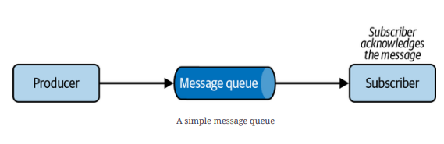
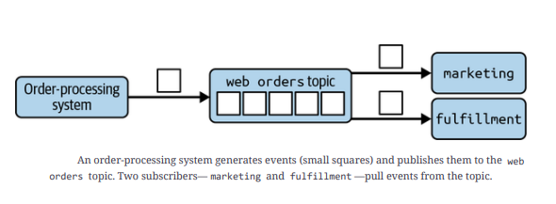
Source Systems(13)
Message Queues and Event-Streaming Platforms

Slide 16
Thank You!
In our next session:

